Slide 1
Stock Forecast
w/ Machine Learning
Jordan Janer
Erika Gonzalez
Alexandra Baker
Farimah Shirmohammadi
Notes:
Jordan

Slide 2
Project Purpose
The goal of this project is to use previous stock stats from datasets to predict future highs and lows with machine learning. In doing so we should be able to answer questions such as what are the strongest stocks to invest in for increased gains, or which stocks to not invest in to avoid losses based on the previous stock history. We will provide an analysis and visualization to help the reader better understand the prediction of stock flow.
Research Question
Can we predict the stock value based on previous history?
Notes:
Jordan

Slide 3
Introduction
Stock market exchange gives the instant results about the share and events related to business performances about share markets. It is however difficult for customers to analyze stock trends according to all of the possible information at hand and in this high demand situation, prediction of the stock market is a big problem. For this machine learning will be used to predict the company stock. By performing this prediction algorithm we can minimize the risk of the investor and maximize their possible profit.
Notes:
Jordan: Here we can ensemble a model that will combine all the factors at time of predicting the stock market prices and some companies listed in National Stock Exchange. In those we proposed a time series and historical data stock predictor. Another aim of the project is to get rid of all the risk occurred at time of the start of the stock market exchange. A variable in this case is the closing of the stock market price. We can classify this under non-linear series forecasting.

Slide 4
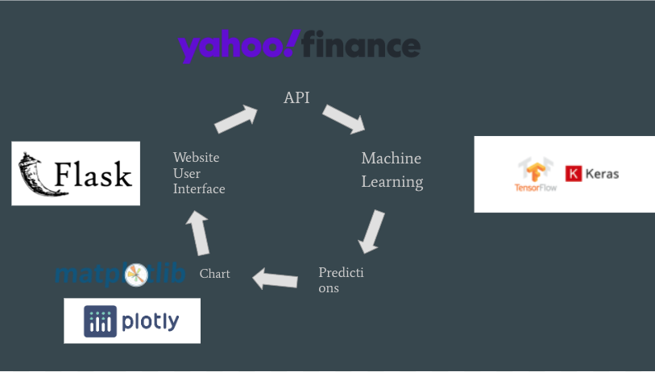
Data
Used Yahoo Finance API to extract S&P 500 data
Initially were going to train S&P 500, DOW, and NASDAQ, but we ran into problems dealing with the size of the data
Ultimately we only used S&P 500 and only used 2 years worth of data to train
Exported into CSV and then used Google Colab for Machine Learning
Notes:
Erika talk about what we did

Slide 5
Long Short Term Memory Model (LSTM)
Class of recurrent neural network (RNN)
Capable of learning long-term dependencies
The input to every LSTM layer must be in three-dimensional:
Batch size = number of training examples utilized in one iteration
Timesteps = number of units(seconds/minutes/hours/days used to predict the future steps
Input_dim = number of dimensions of the features
Notes:
RNN (able to retain information, but not for long)
Remembering information for long periods of time is practically their default behavior which makes this a great model for stock prediction
RNN is a common Deep Learning technique used for continuous data pattern recognition with time series

Slide 6
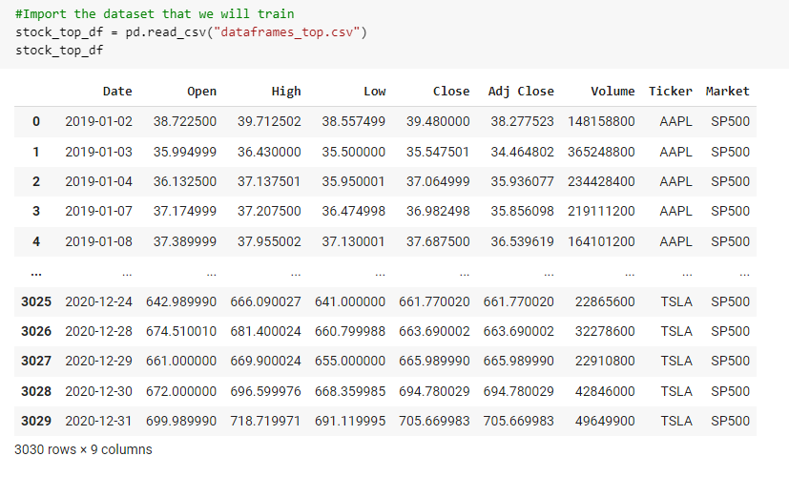
Importing our Data

Slide 7
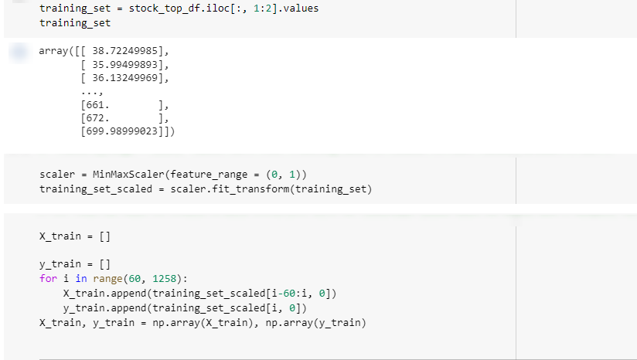
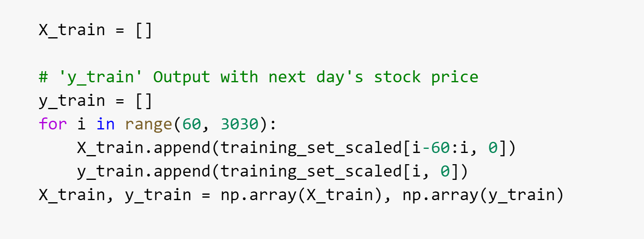
Pre Processing
Notes:
First we needed the the 2nd column “opening” price as a numpy array which is why we used .values.
Used MinMaxScaler to scale the minimum and maximum values to be 0 and 1 respectively or [-1,1] if there are negative values
After we created a data structure with 60 timesteps so in this case looking 60 days. Our y_train output being our next day’s stock price
# Creating a data structure with 60 timesteps (look back 60 days) and 1 output
# This tells the RNN what to remember (Number of timesteps) when predicting the next Stock Price
# The wrong number of timesteps can lead to Overfitting or bogus results
# 'x_train' Input with 60 previous days' stock prices

Slide 8
Reshaping
Notes:
As mentioned before our data needs to be in 3D Here our X-train is being reshaped. we reshape so that [0] = number of rows which is our batch size, [1] number of columns

Slide 9
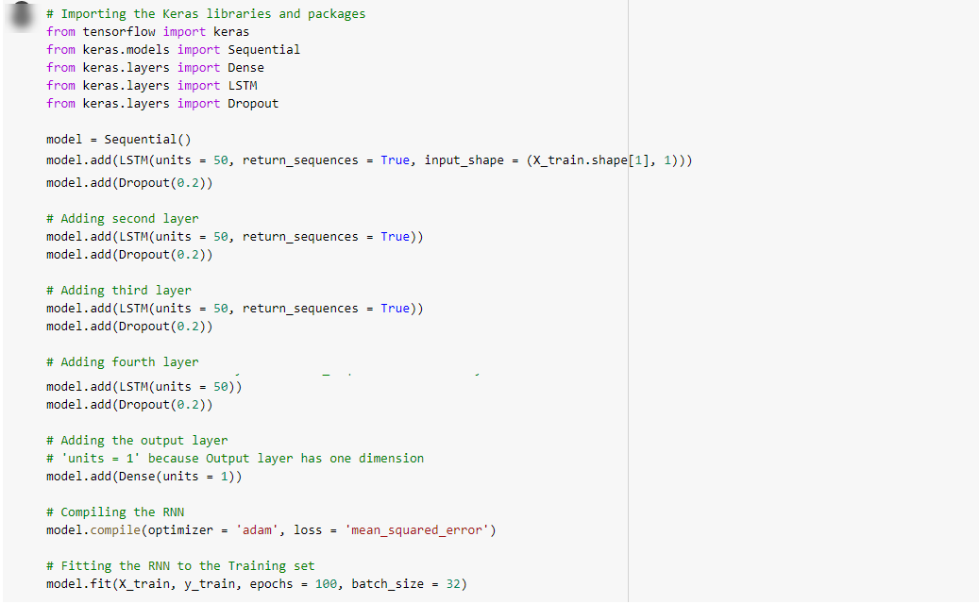
Building our LSTM Model
Notes:
Added 4 layers including an output layer. We also added what’s called a dropout. This dropout is included to avoid overfitting so what this means is that 20% of neurons will be ignored
We compiled our RNN using the ‘adam’ optimerz and then fit the model to the training set

Slide 10
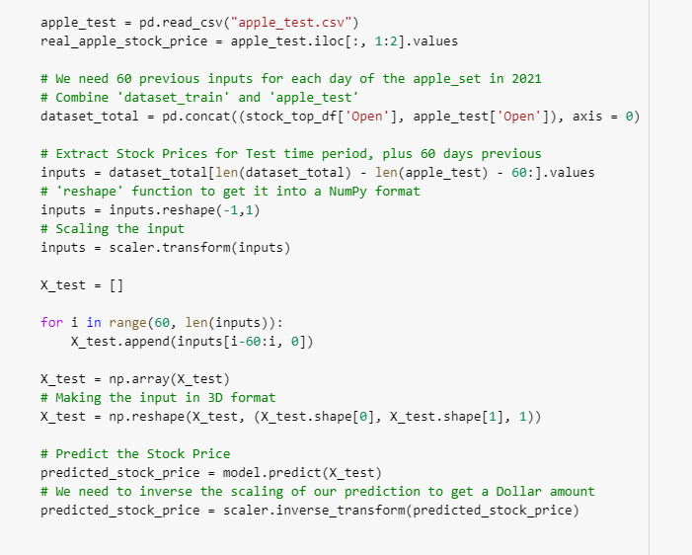
Making the predictions

Slide 11
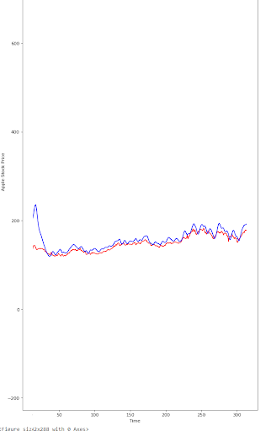
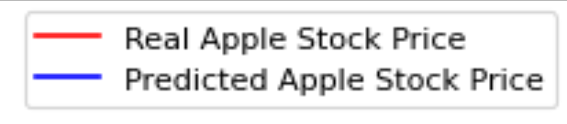
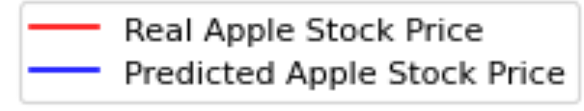
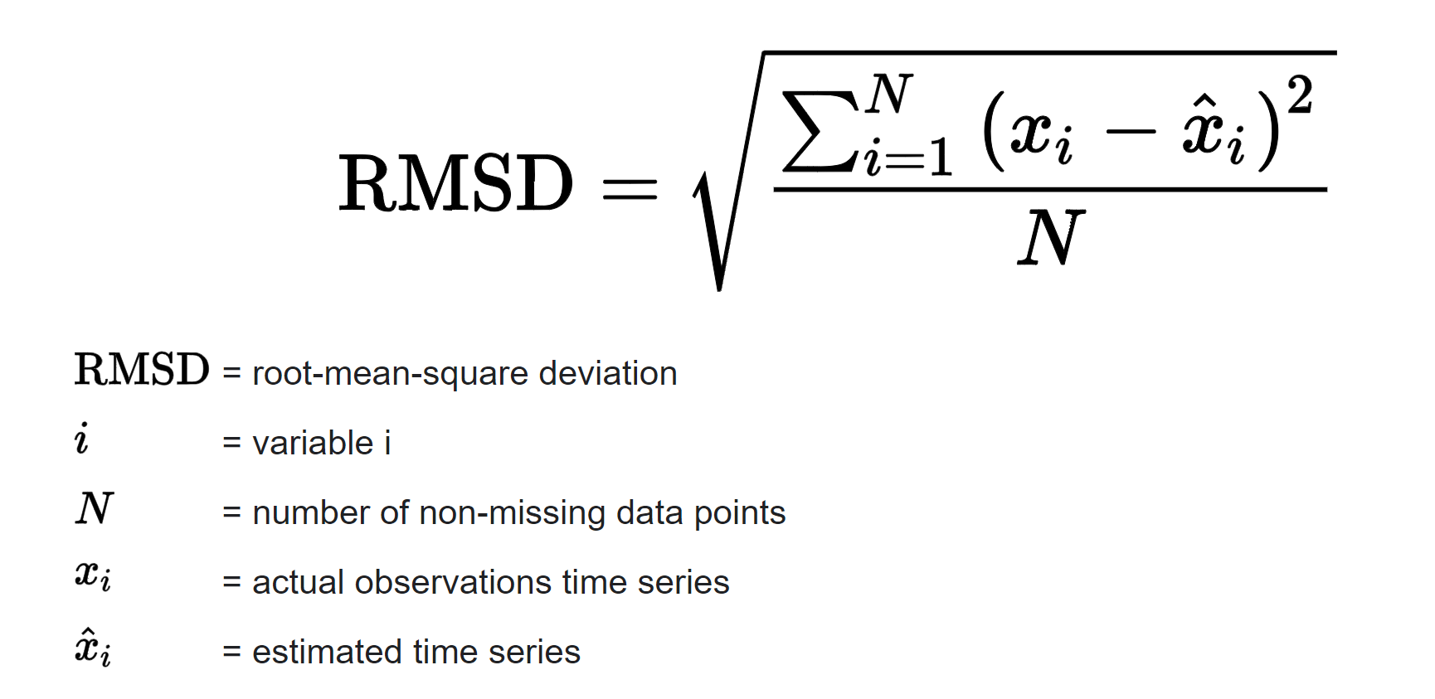
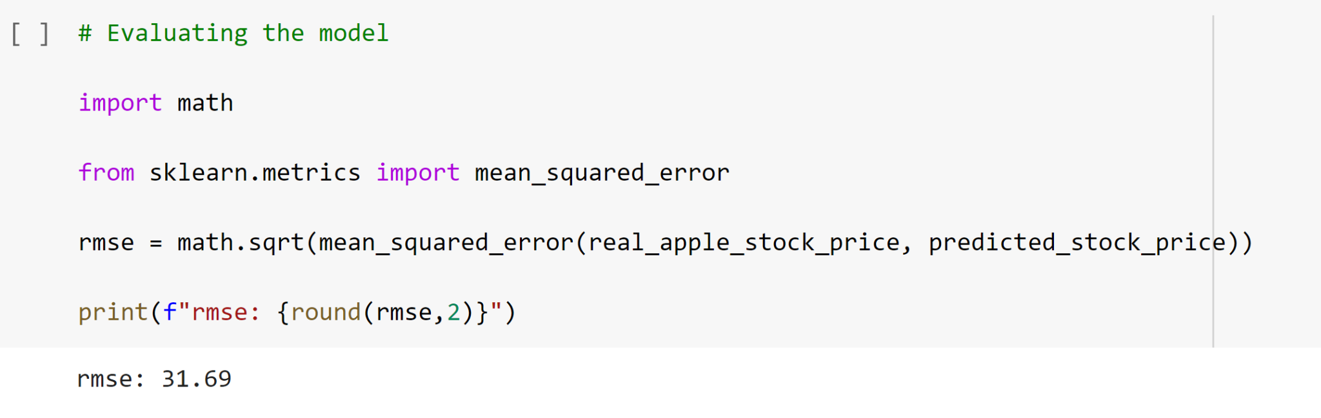
Apple Stock Prediction with 60 TimeSteps
Notes:
Root Mean Square Error (RMSE) is the standard deviation of the residuals (prediction errors). Residuals are a measure of how far from the regression line data points are; RMSE is a measure of how spread out these residuals are. In other words, it tells you how concentrated the data is around the line of best fit.

Slide 12
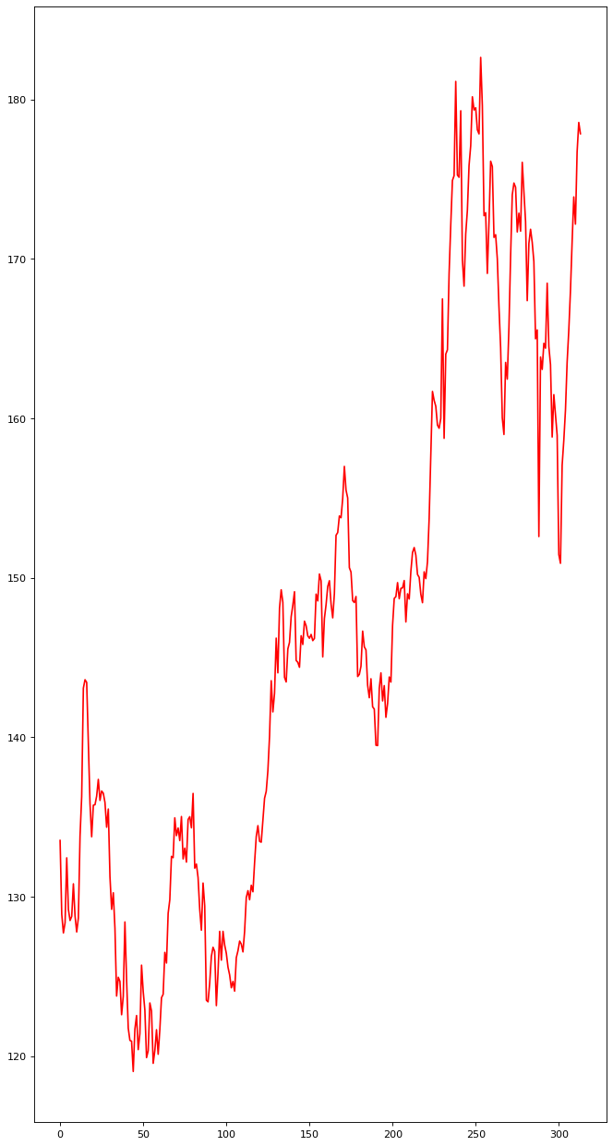
Apple Stock Prediction with 25 TimeSteps

Slide 13
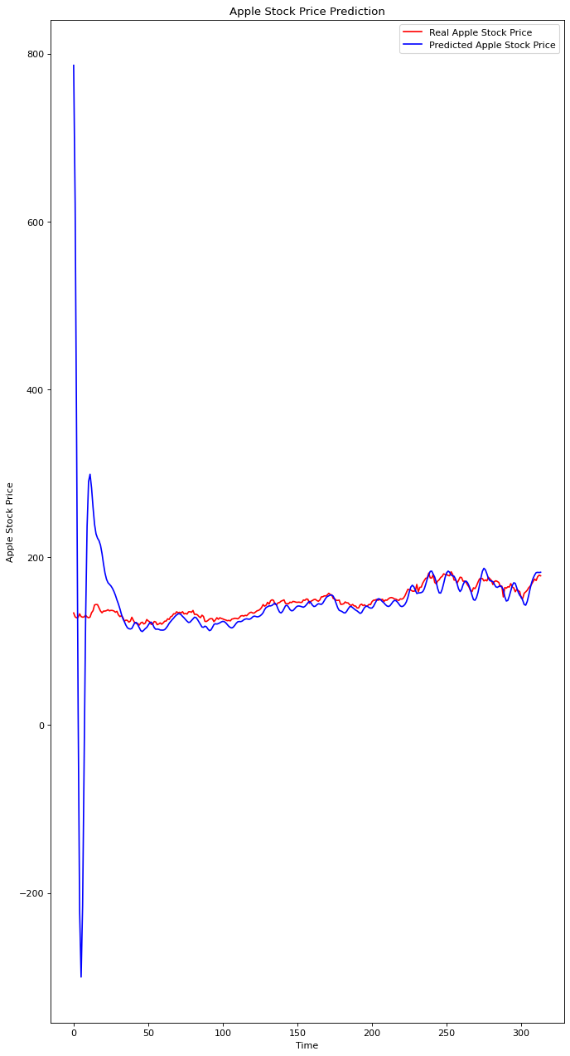
Apple Stock Prediction with 50 TimeSteps

Slide 14
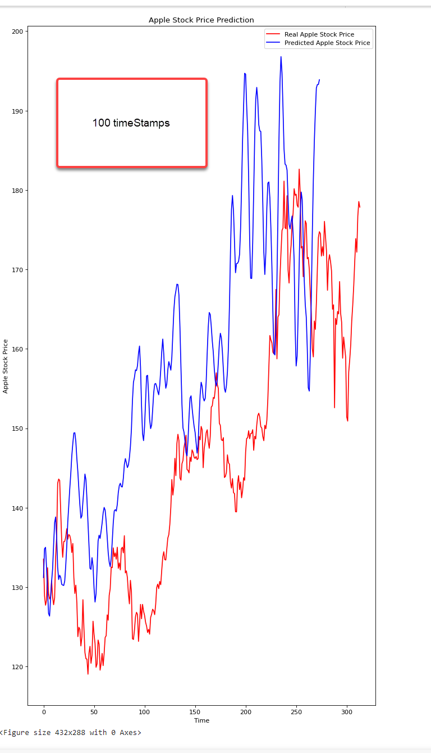
100 TimeSteps

Slide 15
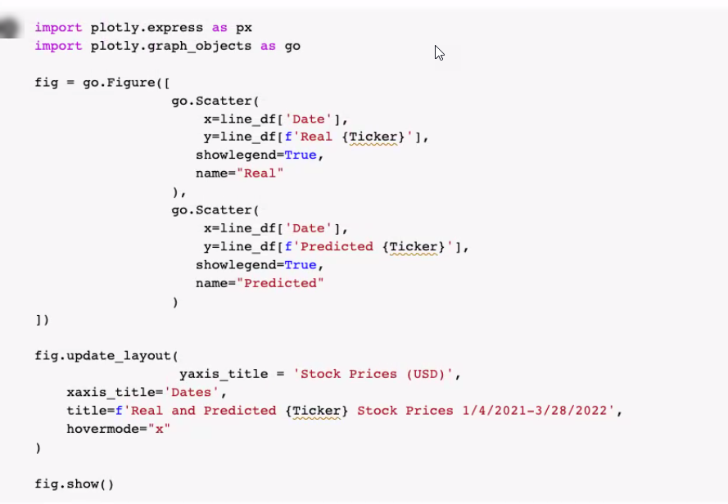
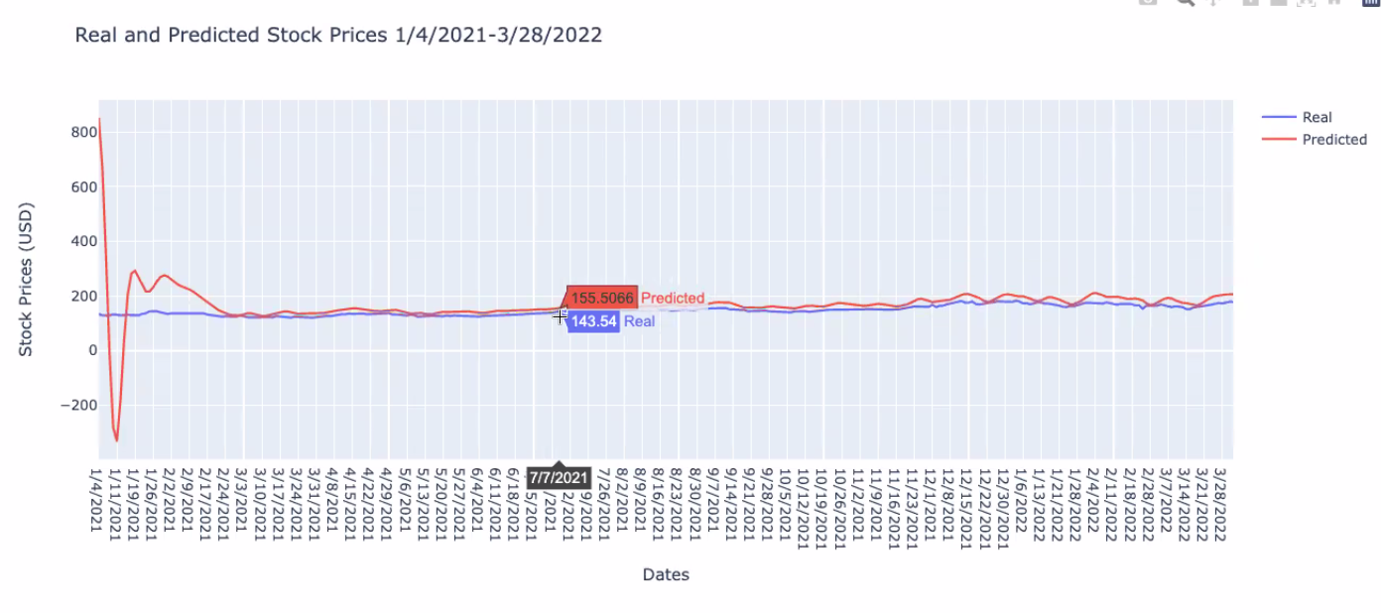
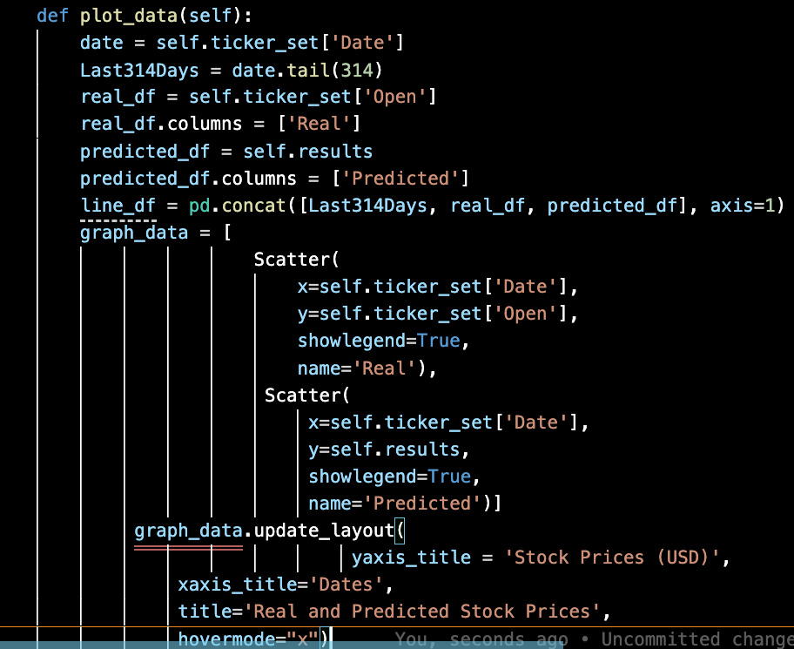
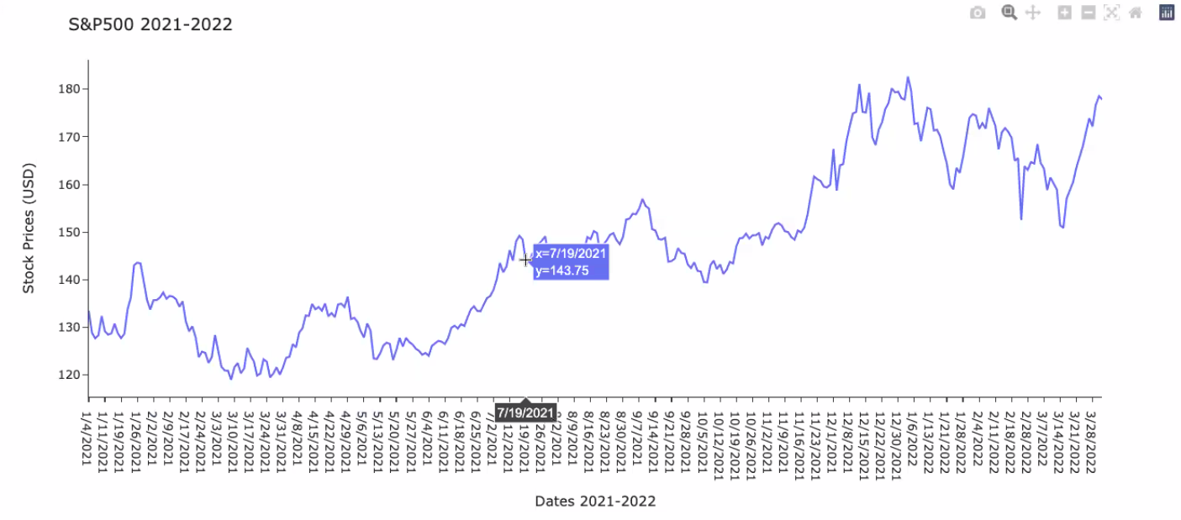
Plotly Charts

Slide 16
DEMO

Slide 17
Conclusion and Limitations
After the creation, reshaping, and training of the model we have concluded that our model is fairly accurate. For improved predictions, we have trained this model on stock price data for companies in the same sector, region, subsidiaries, etc. (in our analysis big techs). Therefore, model prediction results on stock prices of companies out of this sector may not be quite accurate. We also could have included more tech companies in our training, and make our model sector specific for better prediction results. We cut the number of observations to accommodate the heroku limits as well. Our Machine learning model only asks user to input their stock of interest. We could also ask user to input the time period they were interested to look at. However, for the interest of time we set the period as a constant and not a user input variable.
Notes:
Alex
Conclusion
Our model was pretty accurate for sector specific companies, not as accurate for other sectors so in the future we would want to do more training in other training
Another direction would be to make it more user interface specific
Size limitations for training and running in general

Slide 18
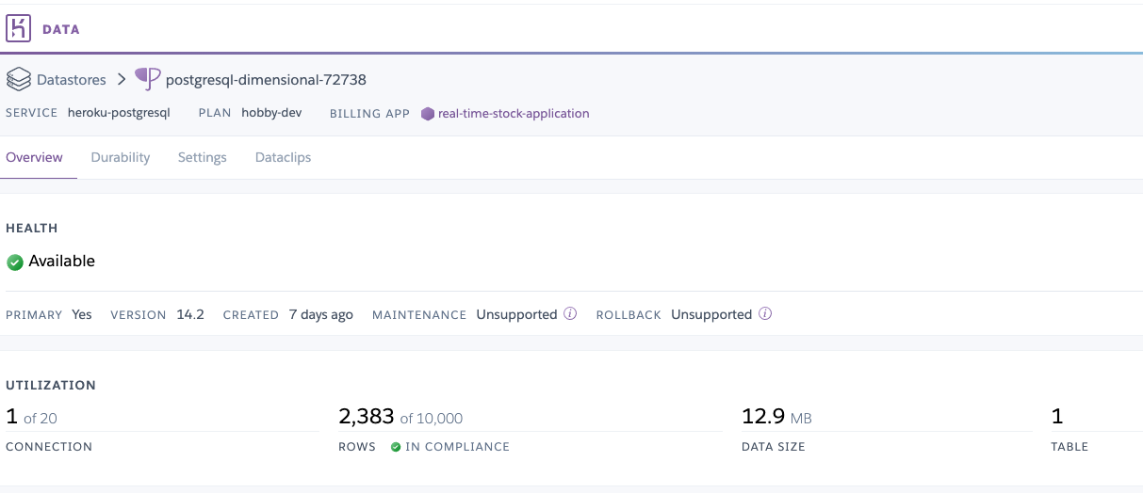
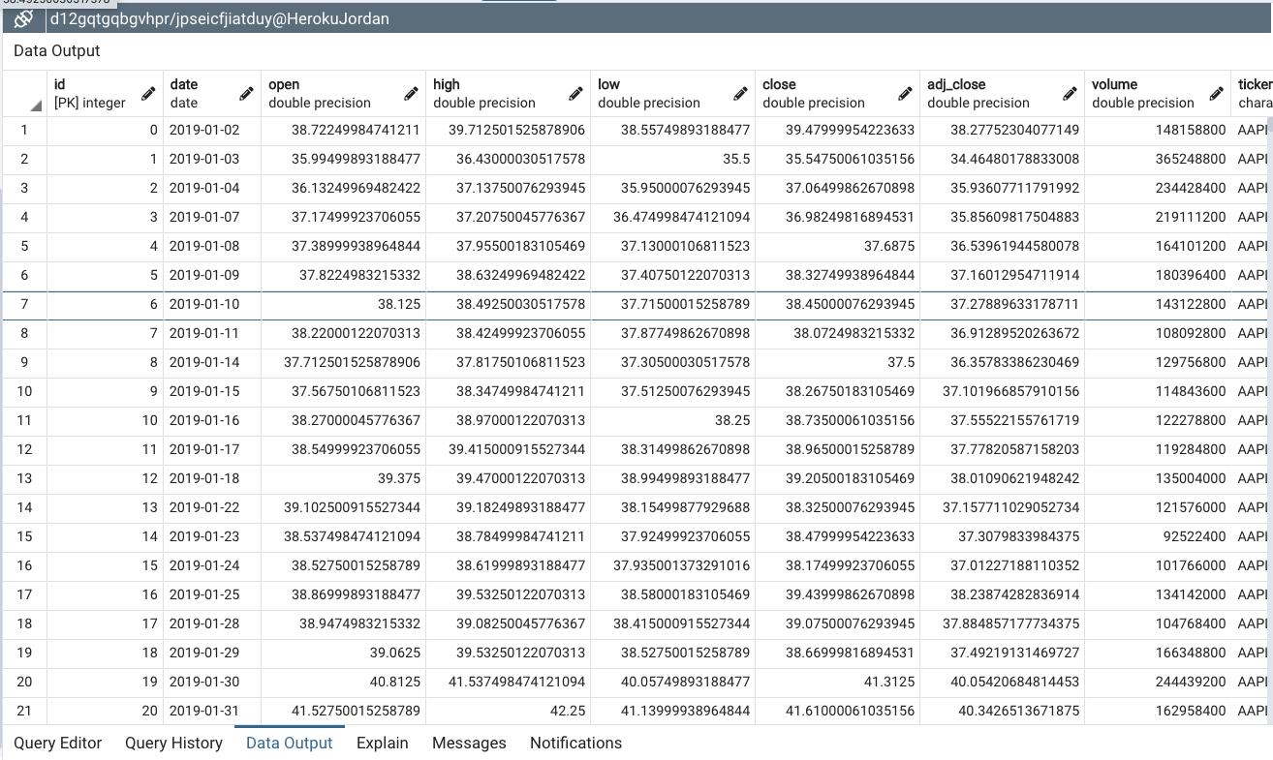
Limitations: Heroku & PostgreSQL

Slide 19
References
http://www.ijstr.org/final-print/mar2020/Prediction-Of-Stock-Market-Exchange-Using-Lstm-Algorithm.pdf
https://datahub.io/core/nasdaq-listings
https://finance.yahoo.com/
https://pkgstore.datahub.io/core/nasdaq-listings/nasdaq-listed-symbols_csv/data/595a1f263719c09a8a0b4a64f17112c6/nasdaq-listed-symbols_csv.csv
https://thecleverprogrammer.com/2020/08/22/real-time-stock-price-with-python/
https://pypi.org/project/yfinance/

